Slide 1
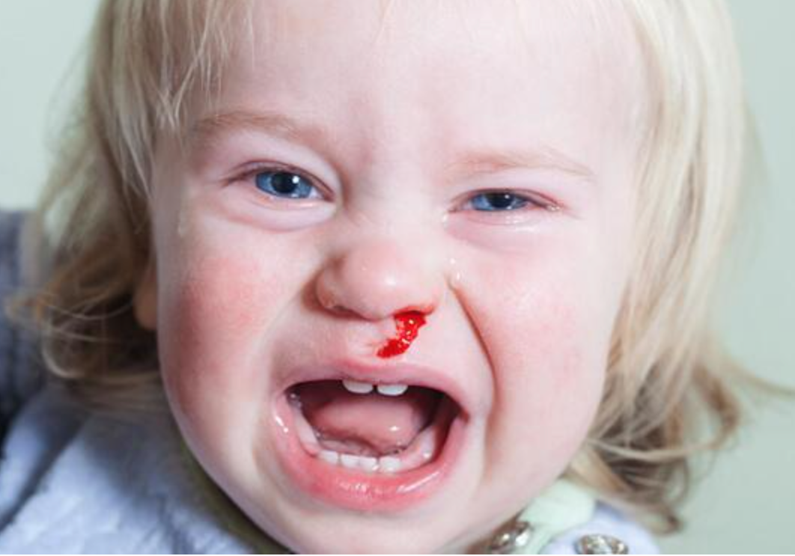
PAEDIATRIC EPISTAXIS
Emma Keane
Sligo University Hospital
National University of Galway

Slide 2
CONTENTS
Problem
Anatomy
Bleeding diathesis
Cases
Special considerations in paediatric population

Slide 3
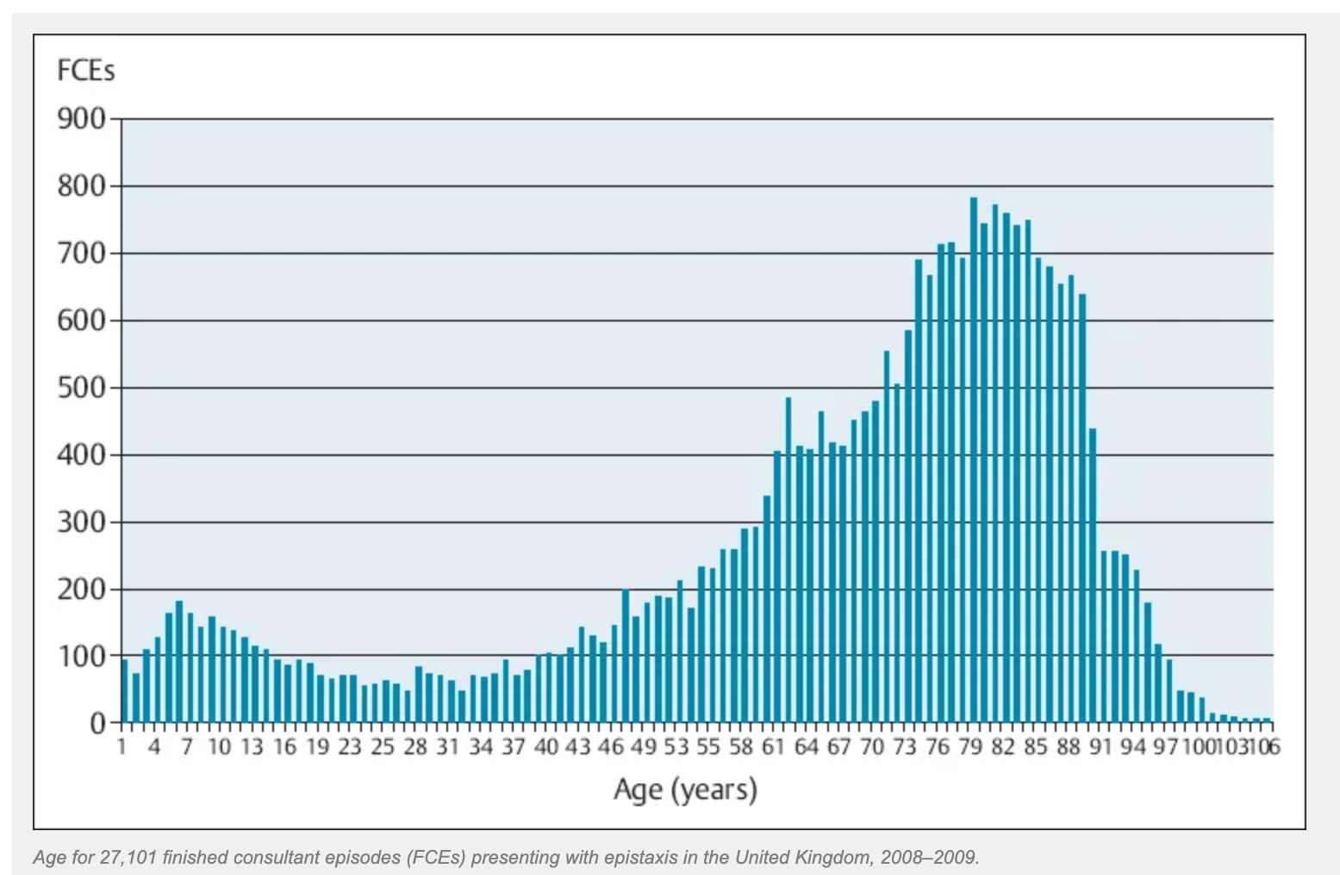
INTRODUCTION
Acute haemorrhage from the nasal cavity, nasopharynx, paranasal sinuses
Estimated that at least 60% of the general population will have had at least 1 nose bleed in their lifetime
50% of all adults presenting with epistaxis had epistaxis in childhood
♂ : ♀︎ = 2:1

Slide 4
Notes:
Considerable economic burden, some excellent irish research and room for updating

Slide 5
ANATOMY

Slide 6
RISK FACTORS
Nose picking
Nasal dryness
Rhinitis
Trauma
Foreign body
Tumour
Bleeding diathesis

Slide 7
INHERITED BLEEDING DISORDERS
Von Willebrand disease (VWD)
Most common
Different types
Combined deficiency of the vitamin K–dependent clotting factors (VKCFD)
II, VII, IX, and X
Haemophilia A
Most common
Deficiency factor VIII
Haemophilia B,
Deficiency factor IX
Haemophilia C
Rare
Deficiency XI
Autosomal recessive
X linked
Recessive

Slide 9
HHT
Define?
An autosomal dominant disorder affecting the contractile elements of blood vessels leading to abnormal blood vessels that bleed easily
Criteria
Curaçao
Treatment options?
HHT centre
MDT approach
Conservative/medical, surgical

Slide 10
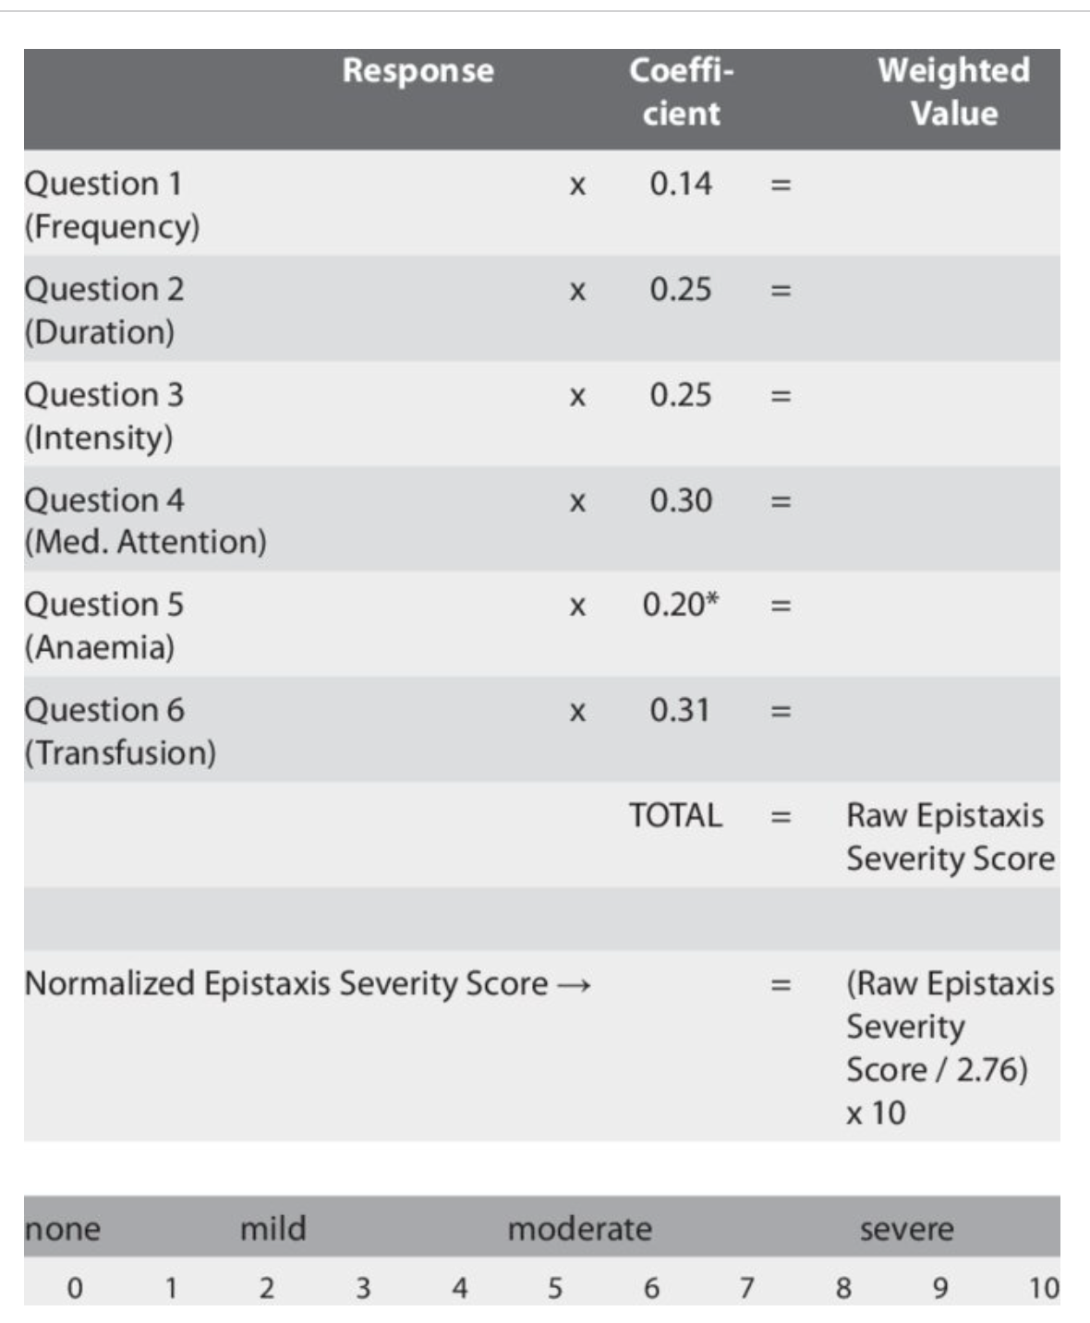
EPISTAXIS SEVERITY SCORE

Slide 11
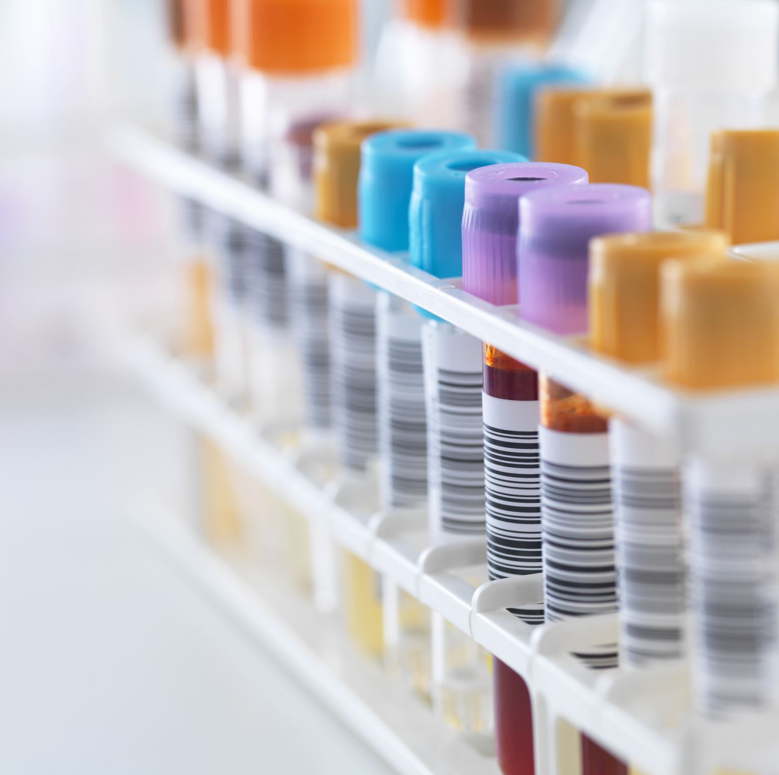
ACQUIRED BLEEDING DISORDERS
DIC/other platelet disorder (ITP etc)
Acquired Haemophilia A
Acquired Von Willebrand
Medication
Liver disease
Infection

Slide 12
CASE 1
GP letter “Please see this 5 year old girl with recurrent epistaxis”
Define recurrent?
Management?
When to do further investigations and what?

Slide 13
SUSPECTED BLEEDING DISORDER?
Clinical judgement
Consider
Clinical presentation
Symptoms
Age
Family history
Degree of bleeding
Menorrhagia
Bleeding with crawling
FBC, platelets
Prothombin Time (PT)
Partial Thromboplastin Time (aPTT)
International Normalised Ratio (INR)
Bleeding time
Notes:
Aptt checking intrinsic pathway PT extrinsic pathway INR vitamin K dependant

Slide 14
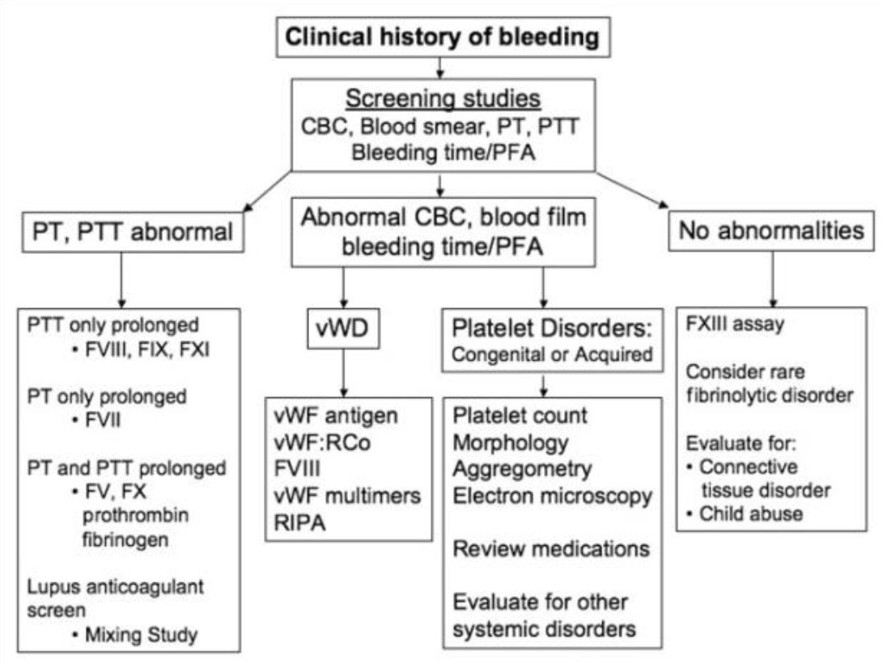

Slide 16
NASEPTIN
What’s in it?
Does it work?
How does it work?

Slide 17
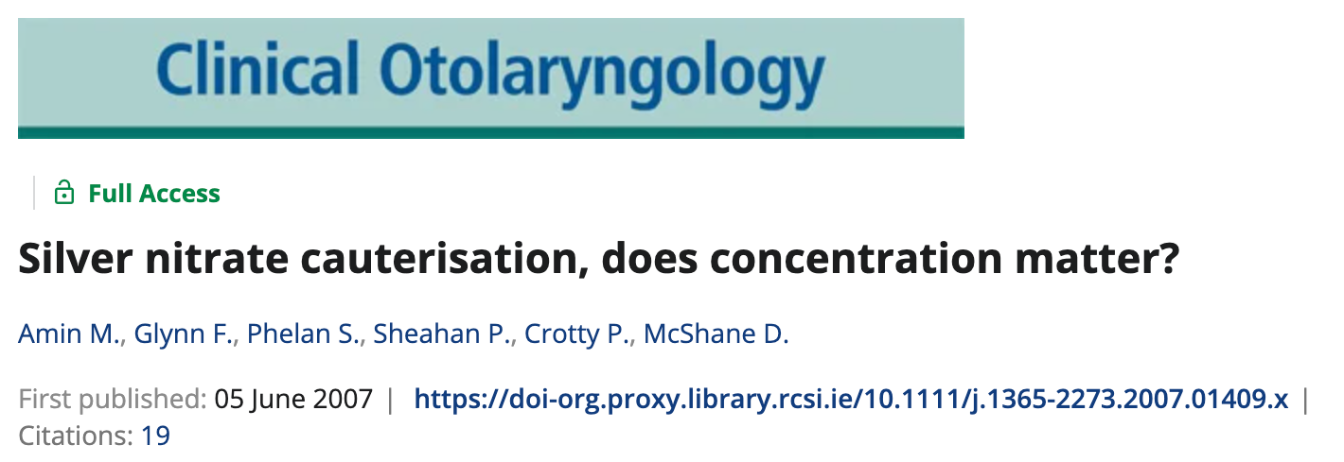
SILVER NITRATE
Notes:
Most widely accepted theory nitric acid generated from silver nitrate and h2o, creating a chemical burn, OR exothermic reaction causing coagulative necrosis, OR alkaline burn from formation of a silver salt (liquefactive necrosis)

Slide 18
DOSING GUIDANCE FOR TOPICAL APPLICATION OF 5% LIDOCAINE AND 0.5% PHENYLEPHRINE
AGE | ESTIMATED/ACTUAL WEIGHT (KG) | MAXIMUM NUMBER OF SPRAYS
1 | 10 | 1
2 | 12 | 1
3 | 14 | 2
4 | 16 | 2
5 | 18 | 2
6 | 25 | 3
7 | 28 | 4
8 | 31 | 4
9 | 34 | 5
10 | 37 | 5
11 | 40 | 6
12+ | 43+ | Max 8

Slide 19
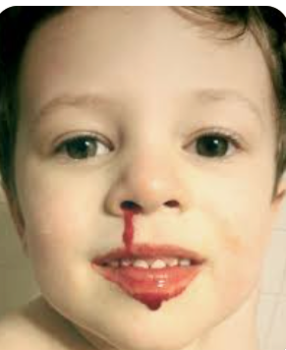
CASE 2
6 year old
Spontaneous haemorrhage, outside playing, no witnessed/reported trauma
Bilateral active bleed, severe, swallowing some blood also

Slide 20
THEATRE?

Slide 21
THEATRE
There is rapid growth in the orbit and midface during the first 6 years of life
Gradual growth between 7 years and adulthood
The length of the medial wall of the orbit doubles
Disproportionate enlargement of its anterior half
“The changing relationships of critical structures in the orbital must be understood to allow safe ethmoidal artery ligation”

Slide 23
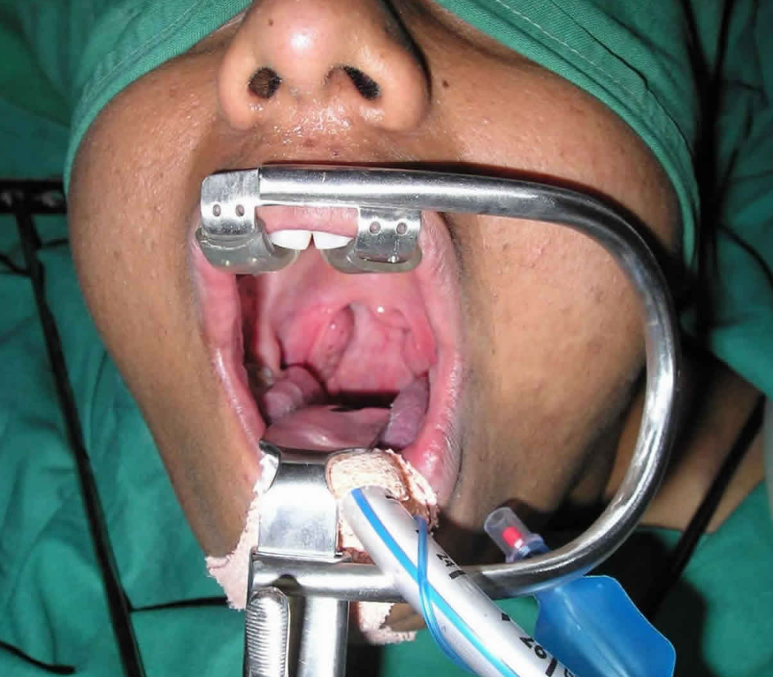
CASE 3
4 year old boy
Adenoidectomy and grommets for recurrent ASOM 3/7 ago
Heavy bleed, swallowing ++
Management?

Slide 24
BLOOD SUPPLY?
ARTERIAL
Basisphenoid artery
Ascending pharyngeal artery
Ascending palatine artery
Pharyngeal branch of the maxillary artery
Tonsillar branch of the facial artery
Artery of the pterygoid canal
VENOUS
Pharyngeal plexus
Pterygoid plexus
Facial veins and internal jugular veins

Slide 25
CLASS OF SHOCK
CLASS | PERCENTAGE BLOOD VOLUME LOST | SIGNS AND SYMPTOMS | TREATMENT
I | 15% | Minor/none | Crystalloid fluid replacement
II | 15-30% | Mild tachycardia Tachypnea Narrow pulse pressure Slightly delayed cap refill | Crystalloid fluid replacement +/- transfusion
III | 30-40% | Tachycardia Tachypnea Hypotension Delayed capillary refill Altered mental status Oliguria | Crystalloid fluid replacement + transfusion
IV | >40% | Cold, pallor Depressed mentation Tachypnea Tachycardia Anuria | Crystalloid fluid replacement + transfusion

Slide 26
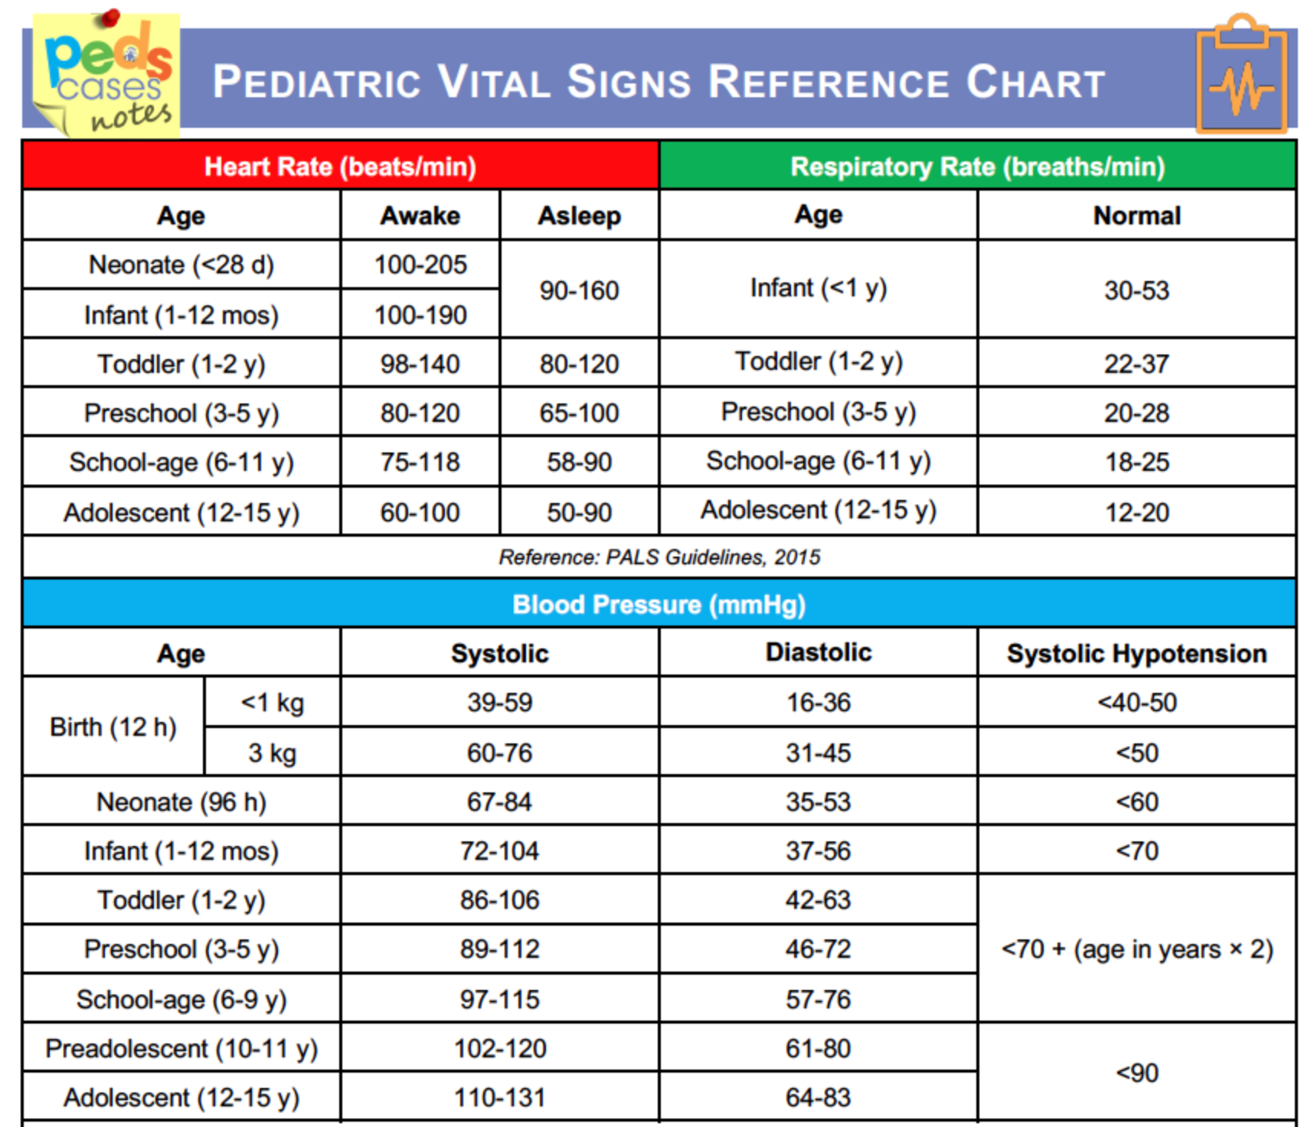

Slide 27
WEIGHT CALCULATION PAEDIATRICS
Weight in kg = [age+4] x 2
For Infants < 12 months: Weight (kg) = (age in months + 9)/2
For Children aged 1-5 years: Weight (kg) = 2 x (age in years + 5)
For Children aged 5-14 years: Weight (kg) = 4 x age in years

Slide 28
TRANEXAMIC ACID
How does it work?
When are you supposed to give it?
How much?

Slide 29
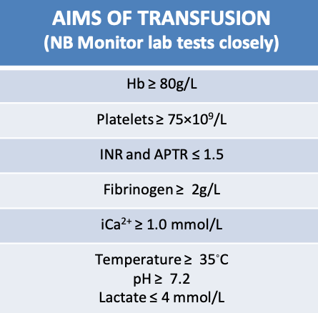
WHEN TO TRANSFUSE
Notes:
A hemoglobin threshold of 8 g/dl or less is recommended for transfusion if patients are symptomatic [11].
There is no agreed hemoglobin level for PRBC transfusions in children admitted to a PICU. The threshold for transfusion may vary with underlying diagnosis and physiologic stability

Slide 30
CASE 4
2 year old girl
Attends creche
Left nasal discharge 3x12
Foul
Occasionally bloody

Slide 31
CASE 4
2 year old girl
Attends creche
Left nasal discharge 3x12
Foul
Occasionally bloody

Slide 32
CASE 5
2 year old girl
Attends creche
At home with granny and 5 year old cousin
Complaining of sore nose, some serosanguinous ooze noted right side

Slide 33
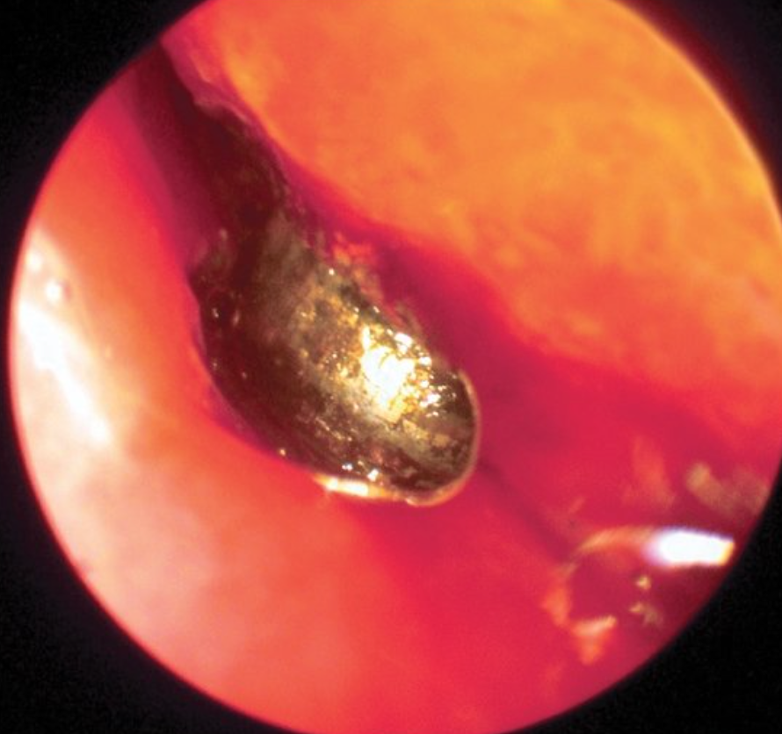
CASE 5
2 year old girl
Attends creche
At home with granny and 5 year old cousin
Complaining of sore nose, some serosanguinous ooze noted right side

Slide 34
BUTTON BATTERY
THEORIES
SEQUELAE
Leakage of battery contents when seal of plastic and the layer separating the anode and cathode mixtures becomes eroded
Local currents when battery is in contact with nasal mucosa
Pressure ischemic necrosis
Generation of hydroxide through electrolysis
As little as 3–6 hours may produce mucosal turbinate and septal ulceration

Slide 35
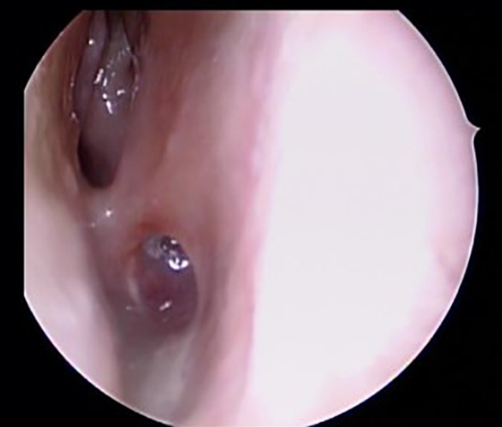
SEQUELAE
Notes:
Inferior meatus ulceration, saddle deformities, chondritis, atrophic rhinitis, alar collapse, septal perforation, and nasal/choanal stenosis

Slide 36
CASE 6
15 year old boy predominantly right sided epistaxis
3 – 4 per week lasting at least 10 minutes
Profuse
Ipsilateral nasal obstruction

Slide 37
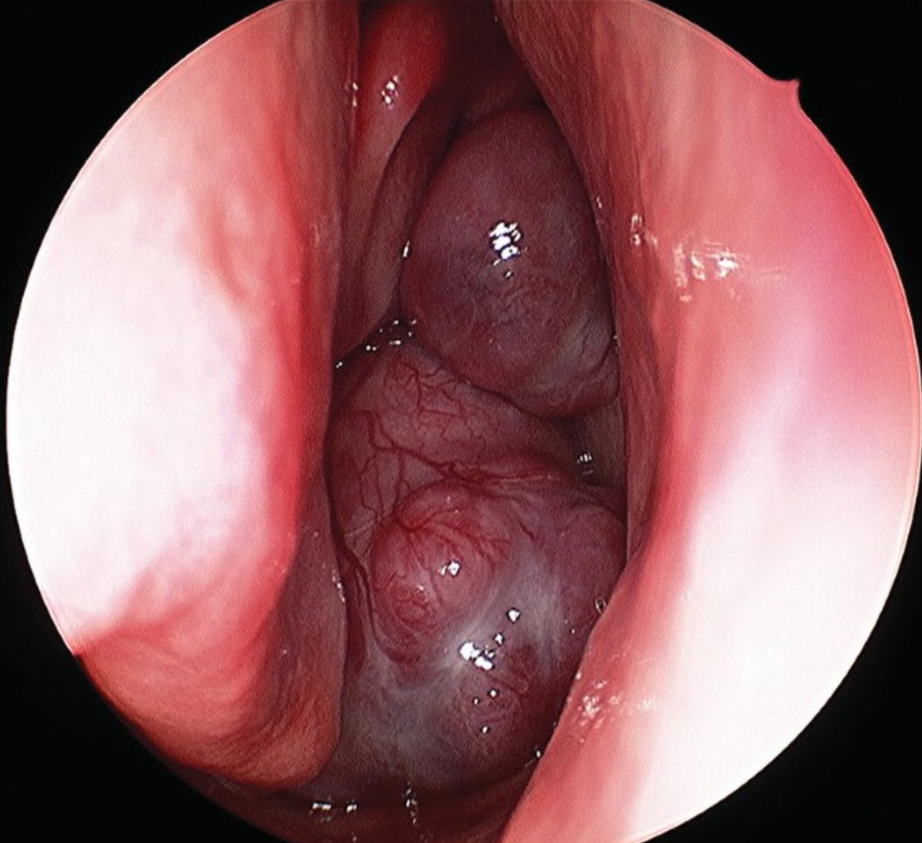

Slide 38
Vividly enhancing mass centred around the sphenopalatine foramen

Slide 39
Salt and pepper appearance due to flow voids within the tumour

Slide 40
Define?
Differential diagnosis?
Blood supply?

Slide 41
BLOOD SUPPLY
External Carotid Artery: (Majority)
IMAX
Ascending pharyngeal
Palatine arteries
Internal Carotid Artery:
(Usually larger tumours)
Sphenoidal branches
Ophthalmic artery

Slide 42
RADKOWSKI STAGING SYSTEM
STAGE | DESCRIPTION
IA | Limited to nose/nasopharynx
IB | Extension into one or more sinuses
IIA | Minimal extension into pterygopalatine fossa
IIB | Occupation of pterygopalatine fossa, with/without erosion of the orbital apex
IIC | Involvement of infratemporal fossa, with/without extension to cheek or posteriorly to the pterygoid plates
IIIA | Erosion of skull base, minimal intracranial component
IIIB | Erosion of skull base, extensive intracranial component, +/- cavernous sinus involvement
Notes:
Multiple staging systems but this is the most common when u go through the literature

Slide 43
TREATMENT OPTIONS
SURGERY
Endoscopic vs open approach
RADIOTHERAPY (Proton Therapy)
Local control 90%
Notes:
Up to 5 DAYS PRIOR, polyvinyl alcohol

Slide 44
ADJUNCTIVE THERAPIES?
AVASTIN
BETA BLOCKADE
Anti-VEGF monoclonal antibody
JNA overexpresses VEGFR2
No clinical data
May induce apoptosis due to involvement of beta 1 receptors in angiogenesis
CHEMOTHERAPEUTIC AGENTS
ANTI-ANDROGEN/HORMONAL THERAPY
Not routinely recommended
Can be used in recurrence or highly aggressive growth patterns
Not widely used
Small case series describe benefit in advanced stage, not statistically significant

Slide 45
OTHER THINGS TO KNOW….
0.05% all head and neck tumours
Recurrence rate of 30%
Significant androgen stimulation is hypothesized
Early-onset JNA (EOJNA)
Systematic review (Gruber et al) identified 28 female patients
Some argue chromosomal analysis should take place
Rare in >30 age, case report female aged 68 (Ralli et al)
Notes:
IMAGING EVERY 7 MONTHS POST OP FOR AT LEAST 3 YEARS

Slide 46
CASE 7

Slide 47
CASE 6
Who?
When?
How?

Slide 49
SUMMARY: HISTORY
Duration
Side of bleeding
Periodicity of episodes
Frequency of episodes
Associated nasal discharge
History of nasal trauma
Bleeding from other sites
Past history of easy bruising/ bleeding problems/haematological abnormality/malignancy
Family history of bleeding disorders
Medications

Slide 50
CONCLUSION
Uncommon <2 years – consider NAI or bleeding disorder
Beware tumour/foreign body
Follow stepwise approach/ATLS protocol
Common FRCS question
High quality Irish research!

