Slide 1
ISCP Induction for RCSI HST Trainees 30th June 2023
www.iscp.ac.uk

Slide 2
ISCP ?????
The Intercollegiate Surgical Curriculum Programme (ISCP) website houses the curriculum for the ten surgical specialties and, in a secure area, trainees’ electronic portfolios and the learning agreements which supports training from ST3 - ST8, and CSCST sign off completion.
The ISCP allows trainees and trainers to interact electronically file assessments and keep an electronic logbook and portfolio.
These include the syllabus for each stage of training, which can be useful for trainees wishing to expand their expertise or check previous training against the current model.
JCST????
The Joint Committee on Surgical Training (JCST)
The JCST is an advisory body to the four surgical Royal Colleges of the UK and Ireland for all matters related to surgical training, and works closely with the Surgical Specialty Associations in Great Britain and Ireland. It is the parent body for the Intercollegiate Surgical Curriculum Programme (ISCP), the ten Specialty Advisory Committees (SACs) one for each of the surgical specialties and the Intercollegiate Core Surgical Training Committee (CSTC).

Slide 3
Register with ISCP: www.iscp.ac.uk

Slide 4
Register with ISCP

Slide 5
Register with ISCP

Slide 6
Complete all sections

Slide 7
Registering with ISCP

Slide 8
You will be asked to pay a trainee fee
DON’T! RCSI pay it directly

Slide 9
Training level
You are ST3
You must select ST3

Slide 10
Enrolment with JCST:
This is essential- You will be asked for your NTN (National Training Number)
Also known as your RCSI number.
IT is NOT your IMC number

Slide 11
Speciality | Training Programme Director (TPD)
Cardiac | Mr Ronan Ryan
ENT | Prof. Guan Khoo
General | Mr Sean Johnston
Neuro | Mr Wail Mohammed
OMFS | Mr Mark Wilson
Paediatric | Ms Sinead Hassett
Plastics | Mr Barry O’Sullivan
T&O | Mr Brendan O’Daly
Urology | Mr Diarmaid Moran
Vascular | Mr Daragh Moneley
Select your relevant Training Programme Director (TPD)

Slide 12
Training history: Add a new placement

Slide 13
More terminology
Training Programme Director (TPD)
Assigned Educational Supervisor (AES)
Clinical Supervisor (CS)

Slide 14
What do you need to do?
Register with ISCP
Complete training and placement details
Upload current CV
Complete learning agreement (3 stages)
Gather evidence on ongoing basis
Complete self assessments, work-based assessments and MSF
Ensure lead CS & AES complete MCRs
Ensure paperwork is uploaded to portfolio in a timely fashion prior to the ARCP for each training year

Slide 15
Typical Placement durations
Speciality | Duration | Start | Finish
Cardiac | 6 months | 11/07/22 | 08/01/23
ENT | 12 months | 11/07/22 | 09/07/23
General | 12 months | 11/07/22 | 09/07/23
Neuro | 6 months | 11/07/22 | 08/01/23
Plastics | 12 months | 11/07/22 | 09/07/23
T&O | 6 months | 11/07/22 | 08/01/23
Urology | 12 months | 11/07/22 | 09/07/23
Vascular | 12 months | 11/07/22 | 09/07/23

Slide 16
MCR: Multiple consultant report
There are TWO for most specialties
Mid
Final
The process is tricky! Give yourself & your trainer plenty of time

Slide 17
Work Based assessments
PBA: Procedure Based Assessment
DOPS: Directly Observed Procedural Skill
CBD: Case based Discussion
CEX: Clinical Evaluation exercise
AoA: Assessment of Audit
OoT: Observation of Teaching
MSF: Multisource feedback

Slide 18
Adding WBAs

Slide 19
WBAs? How many?

Slide 21
Look at your curriculum!

Slide 22
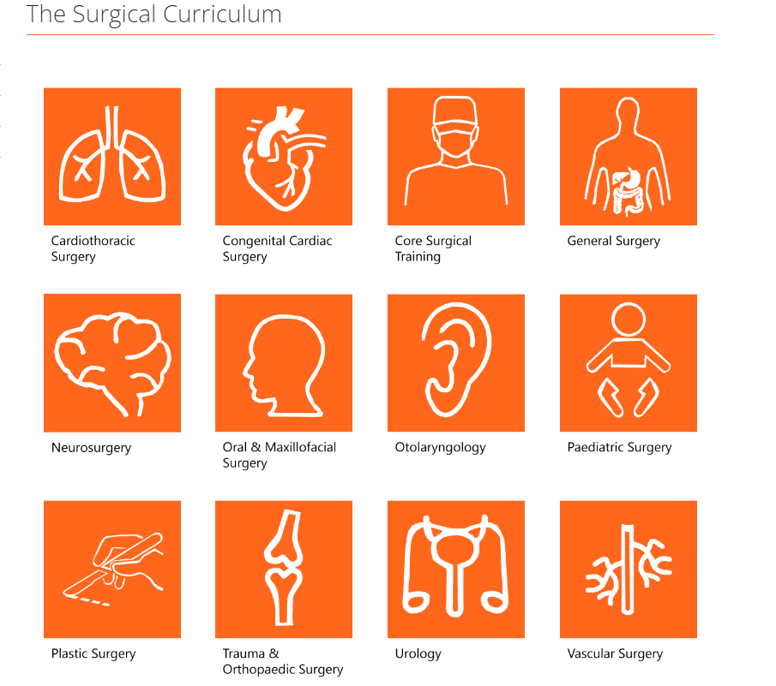

Slide 23
Appendices 3 & 4

Slide 24
Professional Responsibility What do you need to do?
Ensure paperwork is uploaded to portfolio in a timely fashion prior to the ARCP for each training year
Regularly upload your ISCP Portfolio to reflect stages of training
Ensure Training Courses, Certificates eg., Human Factors, Research methodologies are uploaded to “other evidence section”

Slide 25
Use the help/ guidance documents
Where to look…….
www.iscp.ac.uk
HST Intake Guide
Training Session with Dr H. Harty – 20th July 2023

Slide 26
Contact details
Helen Harty PhD
Email: helenharty7@gmail.com
Tel: 00 44 7909524854

