Slide 1
National Surgical Trainer Survey

Slide 2
The key function of the Faculty of Surgical Trainers is to promote, enhance and support the role of the Consultant Surgical Trainer

Slide 3
.
Objectives of the Survey
RCSI committed to supporting trainers in their role
The survey was designed to be a listening process that would give a greater insight and understanding of the training environment.

Slide 4
National Surgical Trainers Survey
The survey was broken down into a number of specific areas:
Knowledge of Trainer Status
Hospital Supports
Assessments and Curriculum
Train the Trainer education
RCSI Supports and Engagement
Awareness of the Department of Surgical Affairs
Involvement in Post Graduate Surgical Training activities
IT Systems
Communication

Slide 5
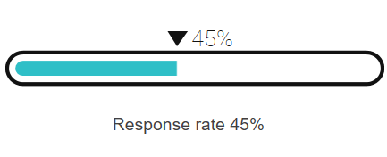
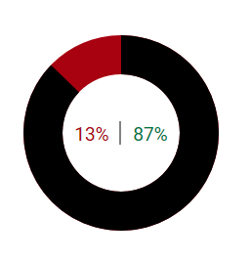
Response Rate
Gender Breakdown of Respondents
87% Male 13% Female

Slide 6
Trainer Status
“Being a Trainer was option would you opt in our opt out”
Opt in 98%

Slide 7
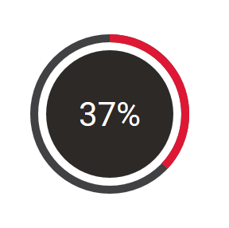
Hospital Supports
“The working environment in my hospital is one that fully supports the confidence building of doctors”

Slide 8
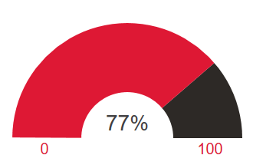
Assessments and Curriculum
“The content of my specialty trainees’ curriculum is appropriate to their needs”
The continued relevance of the curriculum is pivotal to ensuring the graduates from surgical training can deliver the highest quality of patient care

Slide 9
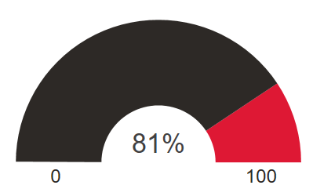
Assessments & Curriculum
“The assessments completed by my trainees are an effective part of their educational development”“
The assessment process has evolved considerably over the past number of years and undoubtedly has added to workload of all surgical trainers
81% of respondents answered positively

Slide 10
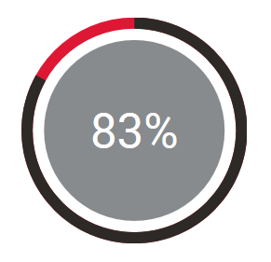
Train the Trainer Education
“I have a clear understanding of the role of a surgical trainer as laid out in the current syllabus”
83% answered positively
A significant section of the survey was allocated to finding out trainer’s views on the importance of trainer training and education and the direction this should take in the future.

Slide 11
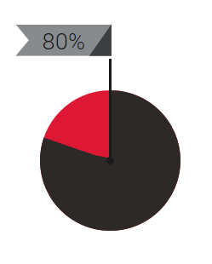
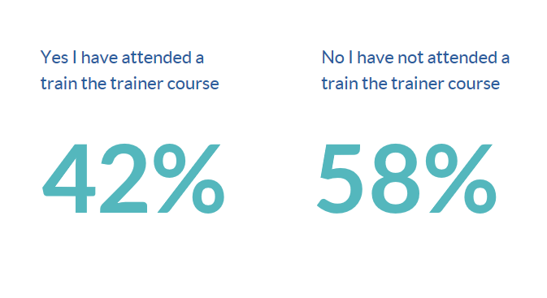
Train the Trainer Education
80% of respondents agreed - Train the Trainer Courses are Beneficial
67% received guidelines from the RCSI

Slide 12
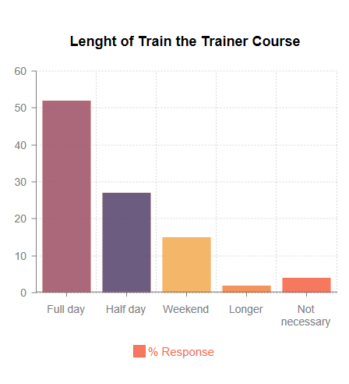
54% of Respondents would support a move to online training

Slide 13
Specific Areas for Training
Identification diagnosis and management of the trainee in difficulty
Balancing the needs of service with education
Giving effective feedback as a trainer

Slide 14
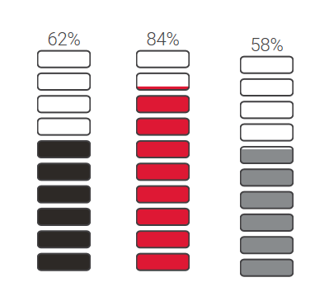
RCSI Support and Engagement for Trainers
62% rated RCSI engagement as acceptable or better
84% would welcome more engagement
58% believed this engagement should take place on the hospital site

Slide 15
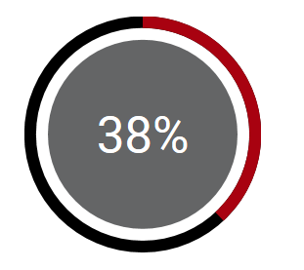
Support for Trainers
Just 38% of Trainers rated the support available to them when addressing trainee performance issues as good or excellent

Slide 16
Awareness of the Department of Surgical Affairs
Level of awareness of the work of Department of Surgical Affairs
Level of awareness of contact at the Department of Surgical Affairs
Level of satisfaction of those who had contacted the Department of Surgical Affairs

Slide 17
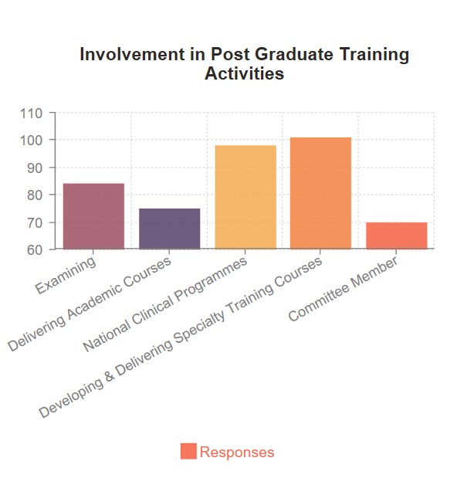
Involvement in Post Graduate Surgical Training Activities
74% of Trainers would like to be more involved with post graduate training activities

Slide 18
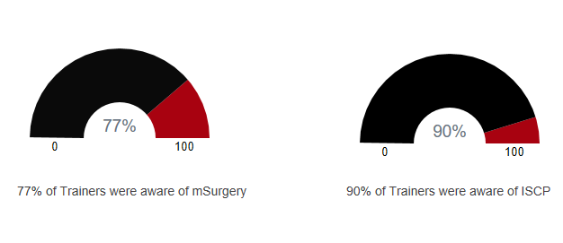
I T Systems
Awareness
IT systems which are now integral to the entire training process
Majority of Trainers supported online training

Slide 19
Communication
The majority trainers preferred to be contacted by email

