Slide 1
Bullying, Harassment and Undermining
January 2019

Slide 2
RACS Video 1
https://www.youtube.com/watch?v=wMZSp6PBCp0&feature=em-share_video_user

Slide 3
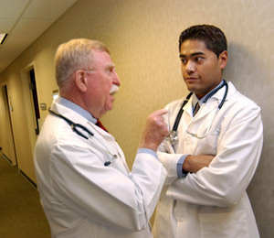
  Bullying
  Bullying defined by the Health and Safety Authority as:
  “repeated inappropriate behaviour direct or indirect, whether verbal, physical or otherwise, conducted by one or more persons against another or others at the place of work in the course of employment, which could reasonably be regarded as undermining the individuals right to dignity at work.”

Slide 4
Examples of Bullying
Aggressive behaviour, shouting, threatening, physical and/or sexual intimidation
Humiliating colleagues in front of staff, patients
Aggressive communication (verbal or electronic)
Spreading malicious rumours
Threats to limit career progression
Notes:
In short, bullying is intimidation designed to frighten and hurt individuals, and to establish or widen a harmful power differential.

Slide 5

  Harassment
  Harassment is defined as being any act or conduct by the alleged offender that is unwelcome to the complainant and could reasonably be regarded as offensive, humiliating or intimidating
  May be spoken words, gestures or the production, display or circulation of written words, pictures etc.

Slide 6
Undermining
Undermining defined by GMC as:
‘behaviour that subverts, weakens or wears away confidence’

Slide 7
Examples of Undermining
Public comments:
  laziness
  incompetence
  belittling
Preventing access to leave, training, opportunity
Applying excessive pressure, setting impossible deadlines
Removing responsibility, failing to give credit, frequent reminders of failure / poor performance
Notes:
Deliberate undermining seeks to diminish an individual’s reputation. In general, undermining behaviour results in individuals feeling excluded, drained of confidence, potentially harassed to the point that their work and psychological health suffer. However, there can be instances where although the trainee feels undermined, the trainer may feel they are maintaining high standards. It takes skill to define exactly what is going on. From a victim’s point of view, it is usually helpful to seek an objective opinion from a third party.
Also important to state that bullying and undermining rarely exist in isolation, they are often experienced together, but we have defined them here separately, for clarity.

Slide 8
‘Your Training Counts’
Irish Medical Council Survey 2014
1,600+ trainees in Ireland
Based on trainee-reported experience,
bullying and undermining behaviours
were endemic in the clinical learning
environment.
3-in-10 trainees reported personal experience of bullying and undermining behaviour

Slide 9
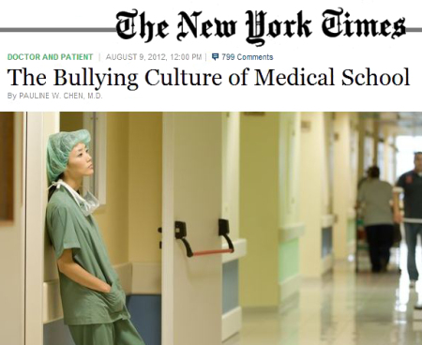
‘Your Training Counts’
Irish Medical Council Survey
greater among trainees at hospitals than among trainees at GP practices.
experience was over 2 times more prevalent than for their UK counterparts.
Where bullying and undermining behaviour was experienced, the frequency was greater among trainees in Ireland compared with their UK counterparts.

Slide 10
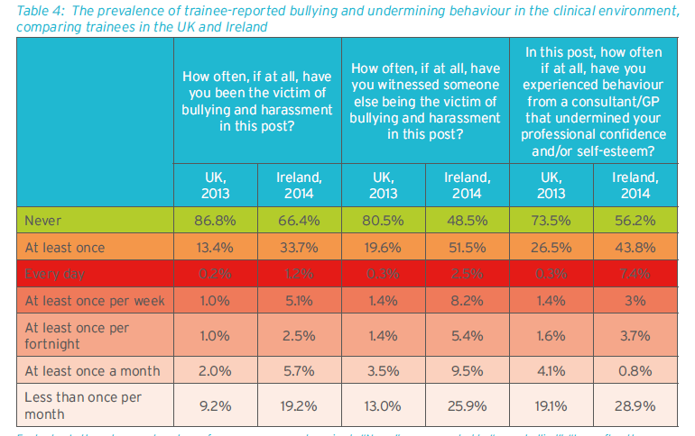

Slide 11
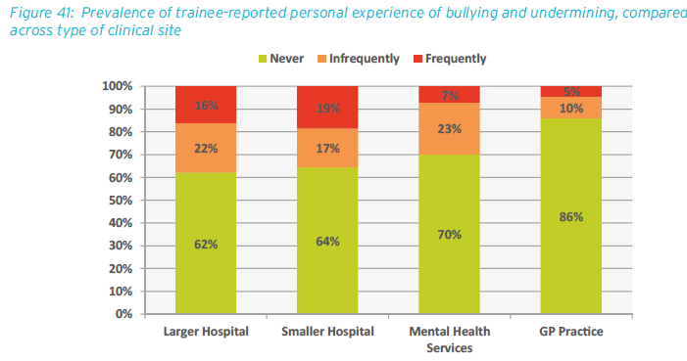

Slide 12

Medical Council Ireland
“In the clinical environment,
through a process of enculturation,
trainees learn what is required of
them and form their identity as
medical professionals.”
“Both experiencing bullying and perceiving others being bullied or undermined is corrosive to the development of medical professionalism.”

Slide 13



Slide 14
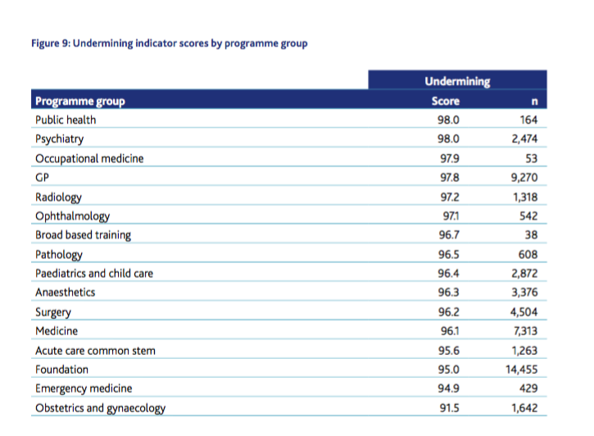

Slide 15
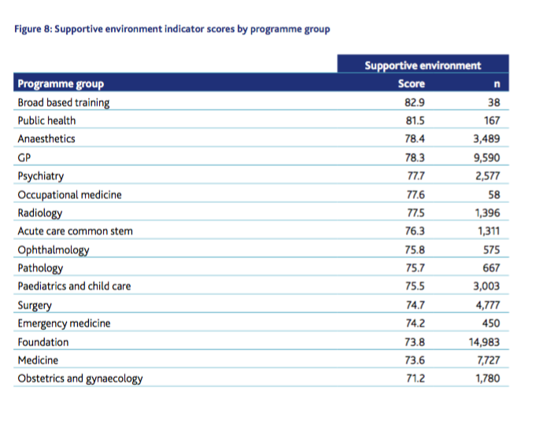

Slide 16
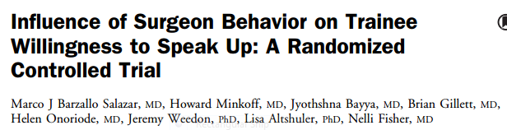
The challenge of speaking up !
80% of medical students vs 30% of medical students questioned a senior surgeon’s incorrect instruction to cut before burning when the surgeon demonstrated an open team-oriented personal style vs a hassled, irritated, authoritarian personal style.

Slide 17
Effects on Patient Safety
Causes depression, anxiety & fatigue among staff
Reduces performance and levels of self esteem
Compromises communication
Serious bullying is the tip of the iceberg
Notes:
Even more subtle unprofessional behaviours – such as passive aggression, public criticism of colleagues, or telling offensive jokes – may interfere with teamwork and the quality of patient care

Slide 18
RACS video 2
https://www.youtube.com/watch?v=UJmITbIWvqw&feature=em-share_video_user

Slide 19
Everyone has the right to feel emotionally safe at work

Slide 20
If you are not the bully or the victim, you are….
Assistant
Reinforcer
Outsiders
Defenders
“The standard you walk past is the standard you accept”
Notes:
Reinforcer: The people who laugh and point fingers, providing positive social reinforcement for bad behaviour.
Outsider:They say nothing.
They see acts of bullying, of harassment, of discrimination and keep quiet
Defender: those that stand up against what is wrong, that want to make a difference

Slide 21
Reporting Bullying is Difficult
Often easier to do nothing
Always wrong to do nothing
Essential to get support
It is easier to defend another person from a bully than to defend yourself
Notes:
Important not to suggest that reporting bullying and undermining is easy – patently it is not. The cost-benefit to the individual, whether reporting as a victim or as an observer, is usually intimidating.
However, you will be vindicated and (at least) have moral satisfaction if you do the right thing.
The only way to change the culture is to report, report, report.

Slide 22
RACS Video 3
https://www.youtube.com/watch?v=Rjb7SZdXvwk&feature=em-share_video_user

Slide 23

When you encounter action that makes you feel uncomfortable
Tell, don’t keep it a secret
Document everything – have a private log or diary
3 actions
  “Your action makes me uncomfortable”
  “Stop what you are doing”
  “Don’t do it again”
Avoid being manipulated or that emotional connection
  Consider written communication if you don’t feel comfortable confronting the bully
Ensure that your behaviour is professional at all times

Slide 24
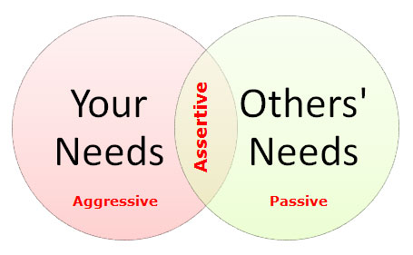
An assertive style….
Use "I" statements.
Listens with empathy and see the conflict from the other person's point of view.

Slide 25
Stepwise Approach
Team
Clinical/educational Supervisor
Clinical Director
Organisation
Medical Director
Human Resources
External
Training Programme Director
HSE Support Person
IMC/Citizens Advice
The law – as a last resort
Notes:
Describe a stepwise approach to reporting bullying, either of yourself or a colleague. Emphasise that it is usually possible to solve problems at a local level without recourse to external bodies.
Legal action should only be considered as a last resort – each higher level that the case is taken to can confer greater stress to the individual, a lengthier investigation process, and more serious consequences for all involved.
However, if you are dissatisfied with the response, do not hesitate to take it to the next level as structures exist to support you.

Slide 26
What to do if you need help regarding bullying/ harassment
Contact Support Person:
  HSE has list of individuals (Available on HSE Website)
  Based outside of hospital
  Role is to advise you about the dignity at work policy which outlines your options; not a counsellor
  ANNONYMOUS
  3-4 visits but need not progress further unless you choose
Consult HR dept. in your hospital
  NO LONGER ANONYMOUS
  HSE process has following steps
    Can you address the situation directly to the bully yourself?
    If no, is there an intermediary from your team you could ask to speak to the bully (eg, SpR, other consultant)?
    If no and you wish to progress it, HR will conduct a formal investigation. Offender will be informed who their accuser is

Slide 27
RACS video 4
https://www.youtube.com/watch?v=Hhx4_ADlAic&feature=em-share_video_user

Slide 28
How to avoid accusations of bullying and undermining
Be self aware
Recognise when you are stressed
Attend workshops and focus groups
Use formal reflection tools / appraisals and informal conversations with friends
Be vocal when you’re overworked

Slide 29
What to do if you need help regarding bullying/ harassment
If you wish to avail of stress counselling confidentially:
  Contact Practitioner Health Matters :Ph: 01 2789369,
  confidential@practitionerhealth.ie. www.practitionerhealth.ie
  Unit B, 3rd Floor, Apex Business Centre, Blackthorn Road, Sandyford, Co. Dublin (01) 2789369
  Other Colleges with useful resources:
  RCSEd (LetsRemoveIt)
  ACEM (DBSH in EM)
  ACS (Let’s Operate with Respect)
  RCOG (Undermining toolkit)
Links to websites and other information on mSurgery
Notes:
Discrimination, Bullying and Sexual Harrassment in EM

Slide 30
Key Messages
Bullying and undermining behaviour is never acceptable
It threatens patient safety
It is not part of Emergency Medicine or Surgery
Report it properly – follow guidance
Notes:
Summary of key messages

